Slide 1


HOSPITAL MANAGEMENT SYSTEM
Group Assignment of Visual Programming I & Database System Programming I University of Vocational Technology .
Department of Networking .

Slide 2

About This System.
Language : C#
Framework : .NET
Used Application: Visual Studio
SQL Server
Referred : Google
Database Name : Hospital
Tables in DB :Patient , Patient_infor
User Name : Admin
Password : admin
.

Slide 3
Methodology.
The hospital management system will be created
in two stages: first, a database will be created; next,
The interface will be customized; finally, the interface
will be programmed, and certain codes will be written.
To implement an end user attractive interface, development team used several react packages like material UI , CSS and designs. Backend is developed using node is. While implementing the backend developers focused on security , authorization , validation, authentication, and performance.

Slide 4

Login Form.

Slide 5

User Name : Admin
Password : admin

Slide 6

Dashboard.

Slide 7
Gif file.
Play in image.
Add Patients Details.
Add Diagnosis Information
About Patients.
Include Patients Full History.
Include Hospital Information.
Can Exit entire system.

Slide 8

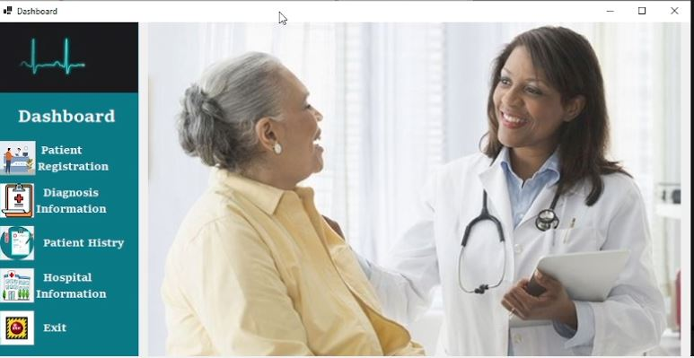

Using a Timer and create a Slide Show to adding any images.

Slide 9
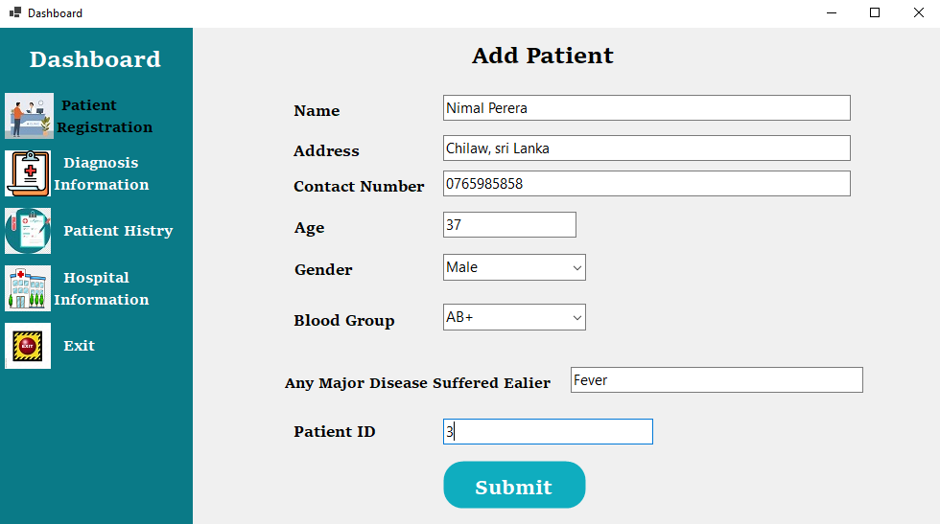
Patients Registration.

Slide 10
Patients Registration.
In this section, the identification data of the patient and basic information of the patient are entered into the system. That is, the patient is registered in the system of the hospital.
Here the patient identification number will be automatically generated by the system which will help to uniquely identify the patient in the system.

Slide 11
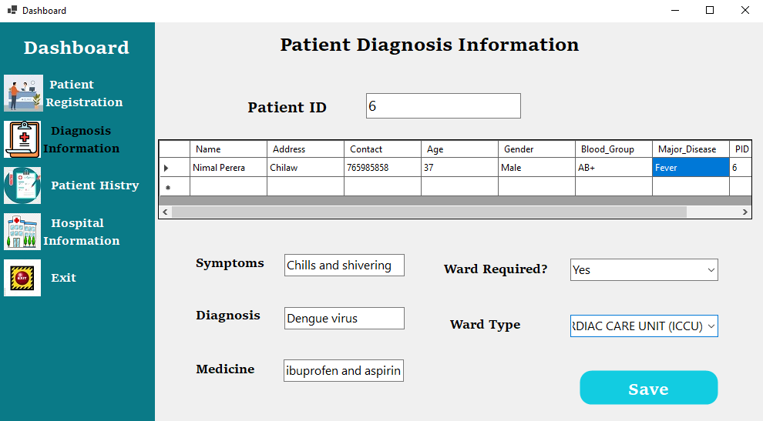
Diagnosis Information.

Slide 12

Here, when the patient's identification number is entered, the basic information of the relevant patient can be obtained and then the diagnosis and treatment provided by the doctor can be entered into this system.‍
Accordingly this data will be saved in another table of the database belonging to the system.

Slide 13
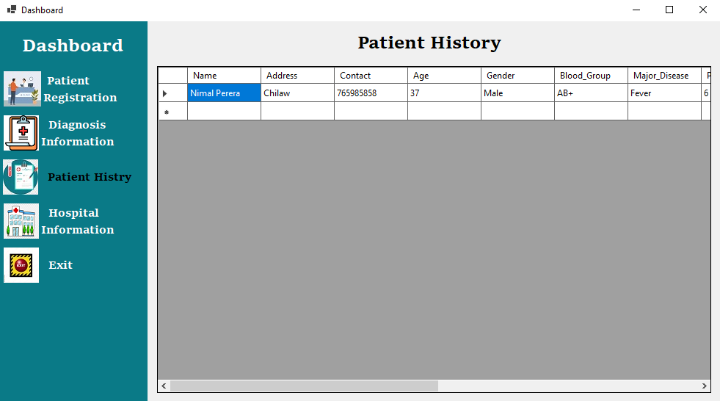
Patient Full History.

Slide 14

This interface enables access to all patient information. That is, the basic data of the patient and the data containing diagnoses and treatments are obtained and displayed from the tables Patient and Patient_infor. It is possible to get the data of all the patients of the hospital at the same time.

Slide 15
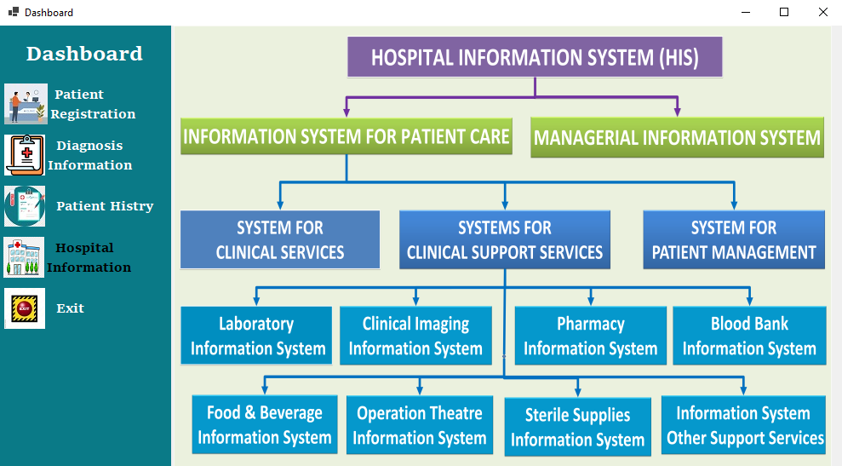
Hospital Information.

Slide 16

This interface helps the system operator to get an immediate understanding of the services and facilities available in the respective hospital as well as the hierarchy of the hospital system. That will make it easier for him or her to provide a higher quality service to their client patients by referring the relevant patient to the relevant services promptly.

Slide 17
Objectives in Hospital Management System.
Cost reduction.
Data management.
User experience.
Patient management.
Patient scheduling system.
A hospital management system also includes:
Patient records, Patient management, Patient scheduling system , Cost reduction.

Slide 18
Thank you..!
Group Members :
NET/21/B1/01 | P.A.M.Pushpakumari
NET/21/B1/24 | A.R.N.V.Aluthgama
NET/21/B1/27 | U.C.Gunarathna
NET/21/B1/30 | W.J.S.Yanupriya
NET/21/B1/16 | R.G.S.D.Gunarathna

